Slide 1
CS302 : Analysis and Design of Algorithms
Title : Dynamic Connectivity
Group Number : 26
Anubhav Kataria - 2020CSB1073
Jugal Chapatwala - 2020CSB1082
Gautam Sethia - 2020CSB1086
Jatin_ - 2020CSB1090
Prakhar Saxena - 2020CSB1111

Slide 2
Problem Statement
As dynamic graphs extends normal graphs by the possibility of representing change within the underlying information over time. We present fully dynamic algorithm that maintains connectivity in polylogarithmic time per edge insertion or deletion. Here, by fully dynamic we mean that the graph may be updated by insertion and deletion of edges and not vertices.
Let n denote the number of nodes in the graph. For a sequence of Ω(mo) operations where mo is the number of edges in the initial graph, the expected time for p updates is O(p*log²(n)) for connectivity.

Slide 3
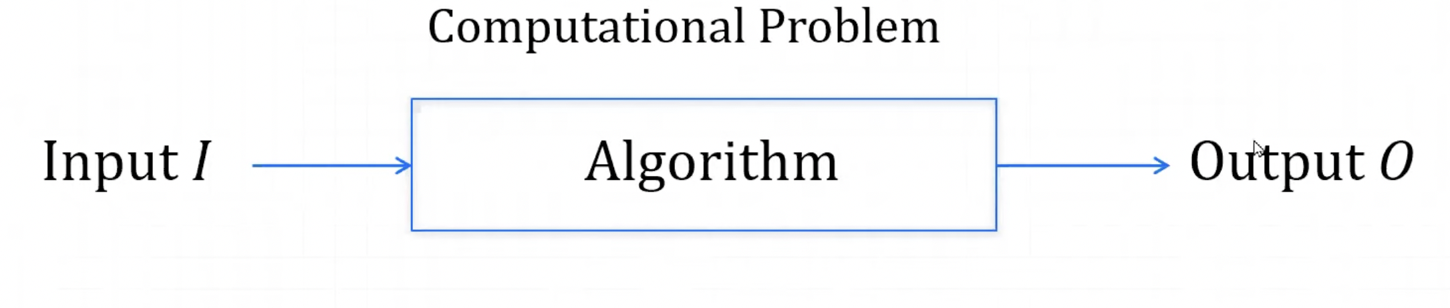
Static Setting
When for a computational problem you have an input which after running through your algorithm gives some output. We have a keen interest in it’s performance measure which include:
Running Time
Quality of the result (correctness and approximation of the result)

Slide 4
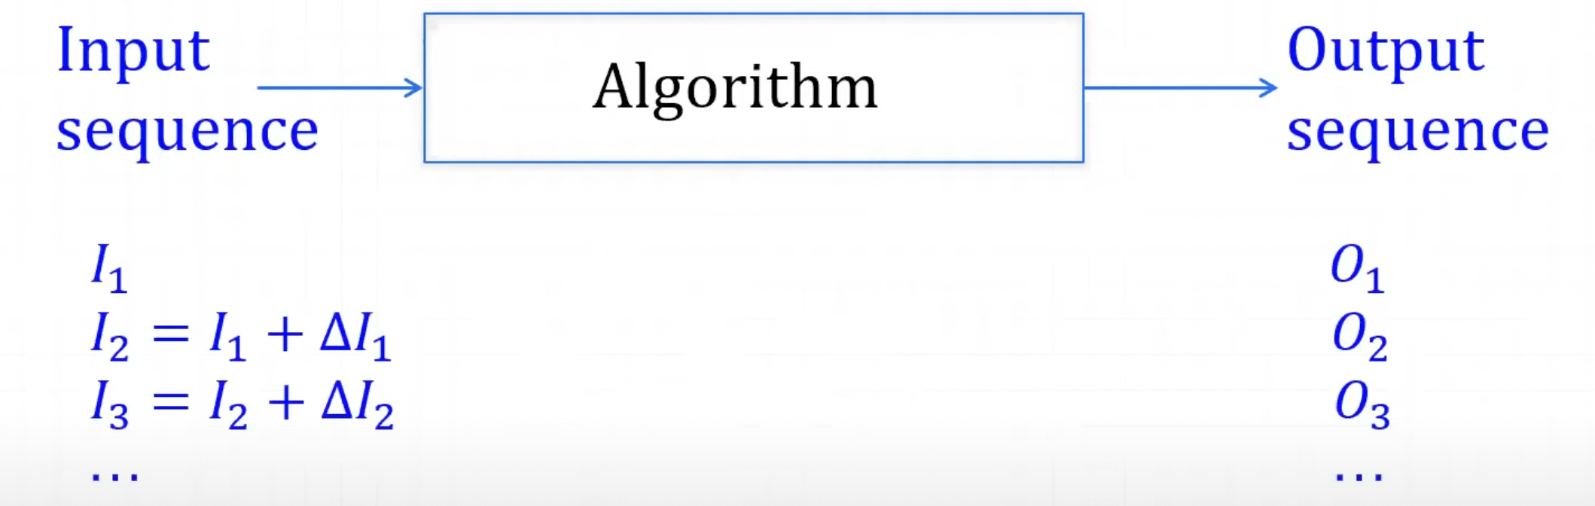
Dynamic Setting
If the input given to the static setting changes slightly do we have a way to compute the output faster rather than running the static algorithm from scratch?
The goal of the dynamic algorithm is we want to store information about i^{th} execution of the algorithm to improve the execution of (i+1)^{th} execution.

Slide 5
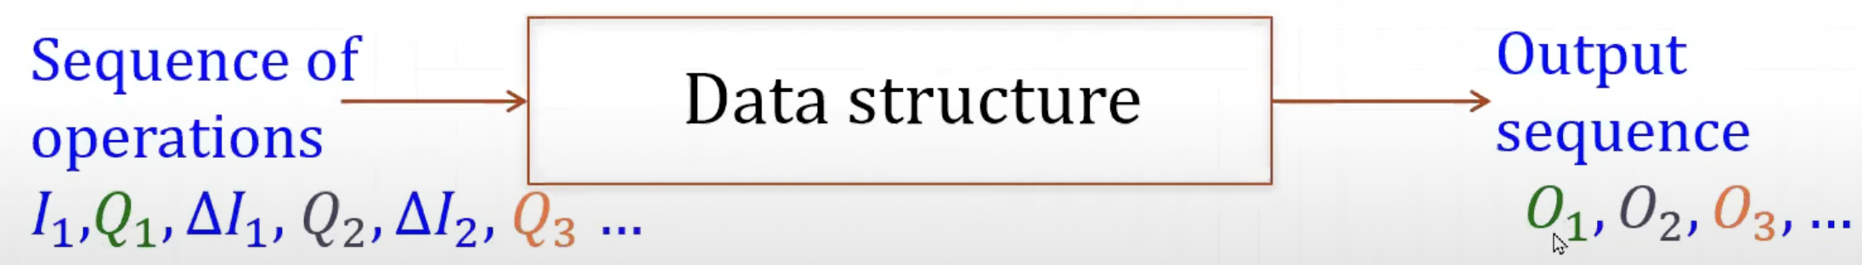
Dynamic Data Structure
We want the data structure to store information from the first run to the second run i.e. it allows you to keep some information
Also it allows you to modify the input (update operation) and get the output (query operation) .
So now we get an input and a Query(Q1) to get an output (O1) then there is some change in input to get our new input (I1 + ΔI1) after which we run another query to get it’s output (O2) and so on…

Slide 6
Dynamic Graph Operations
Specific Operations for dynamic graphs include:
Initialise : Give the initial graph to the data structure and is only executed once. It is the preprocessing step.
Update : It depicts the operations that makes some changes in the graph. It includes operations like INSERT_EDGE(u,v) and DELETE_EDGE(u,v).
Query : The operations that gives us some information about the graph are included in these operation type like to CONNECTED(u,v) .

Slide 7
Euler Tour Tree
To solve the dynamic connectivity problem in forest Henzinger and King proposed the Euler Tour Tree Data Structure.
It stores the Euler Tour of a graph and supports operations like
makeRoot(u)
link(u,v)
cut(u,v)
All in O(log(n)) time

Slide 8
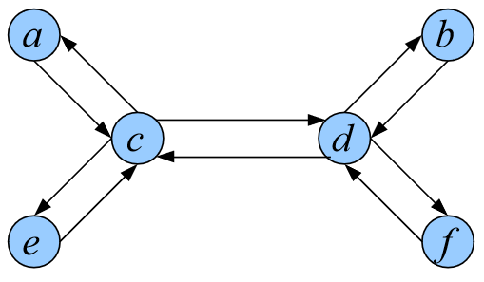
Euler Tour Tree
What are Euler Tours ?
In a graph G an Euler Tour is a path through the graph that visits every edge exactly once.
To make a tree Euler Traversable we replace each edge {u,v} of the tree with (u,v) and (v,u). Representing a tree this way we can ensure that the tree has an Euler Tour.

Slide 9
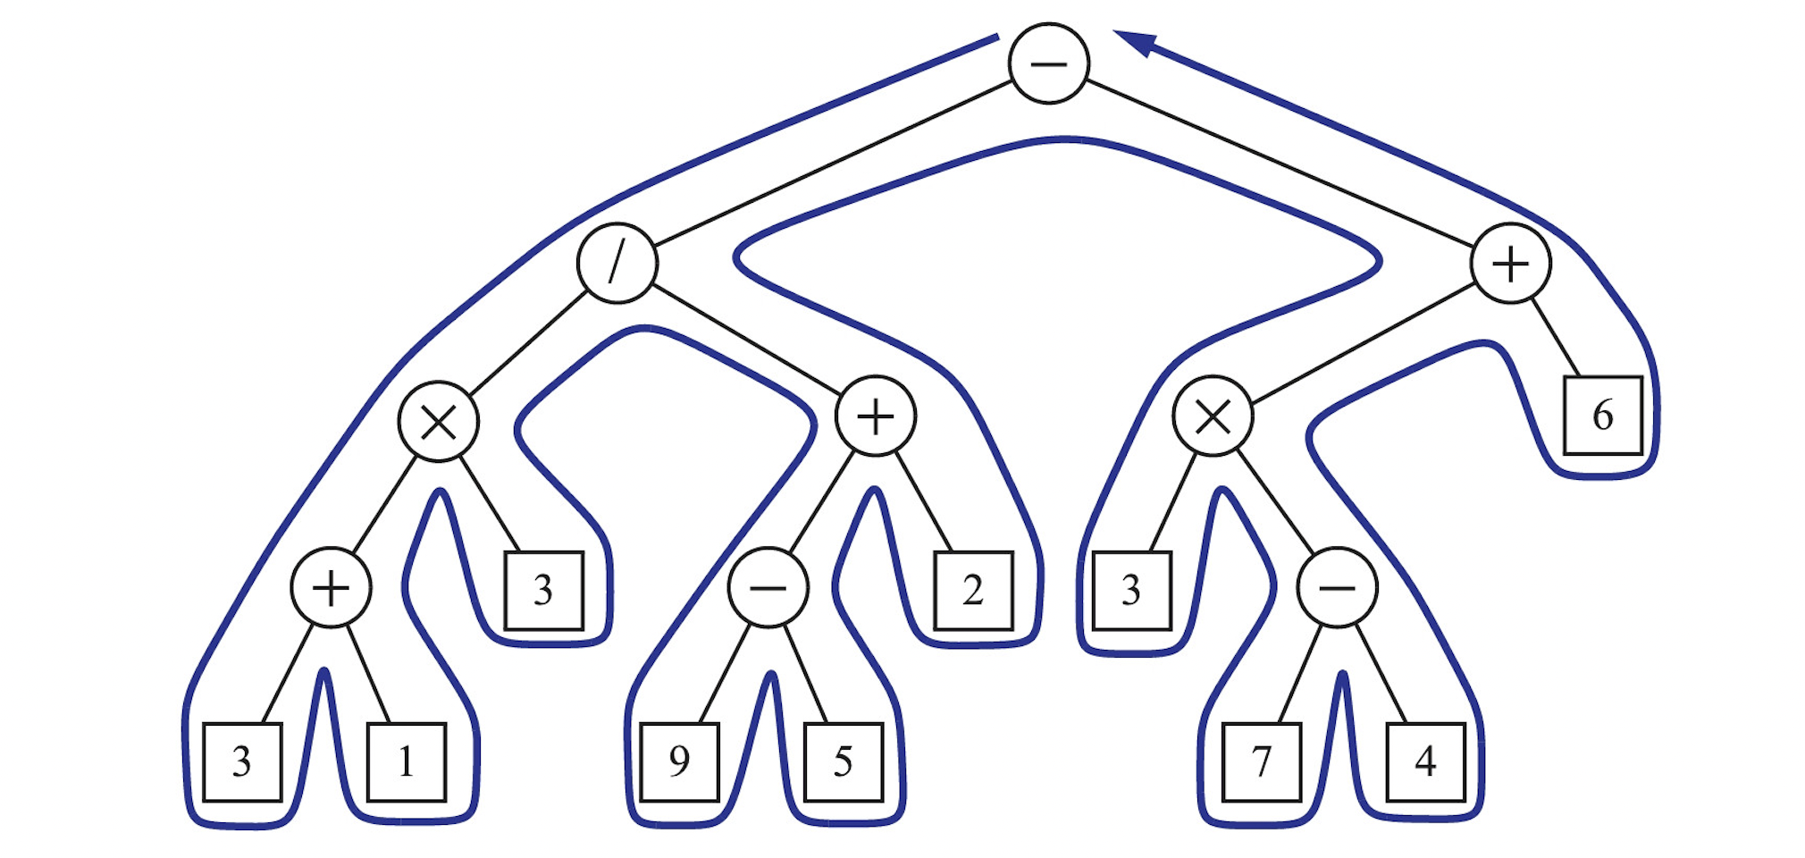
Euler Tour Tree
makeRoot(u) : changes the Euler Tour such that the tour starts from vertex u.
Pick any occurrence of u in the current tour.
Split the tour into two parts A and B, where B is the part of the tour before the picked node.
Delete the first node of B and append u.
Concatenate A and B such that A comes before B.

Slide 10
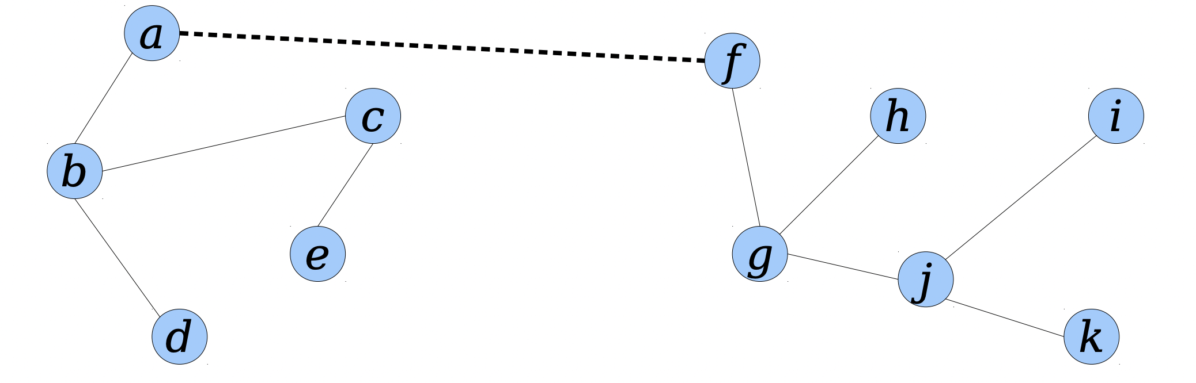
Euler Tour Tree
link(u,v) : changes the Euler Tour incorporating a new edge {u,v}.
Let E1 and E2 be Euler Tour of tree containing u and v respectively.
makeRoot(u)
makeRoot(v)
Concatenate E1, E2 , {u}.

Slide 11
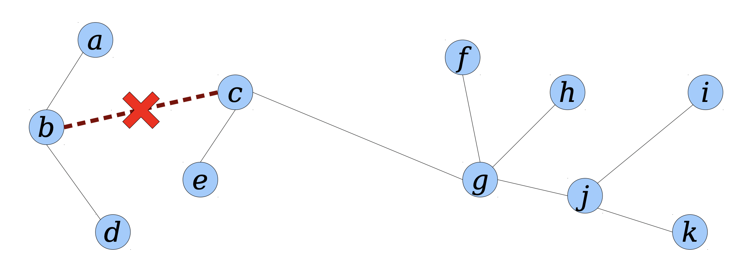
Euler Tour Tree
cut(u,v): returns 2 Euler Tours formed after removing {u,v}.
Let E be Euler Tour for T.
Split E at (u,v) and (v,u) to get J, K, L in that order.
Delete the last entry of J.
Then E1 = K.
Then E1 = J, L.

Slide 12
Euler Tour Tree
In Euler Tour Tree data structure we represent the Euler Tour in a balanced binary tree.
The above operations can be written as a series of constant number of split() and join() operations on that binary tree. This ensures that these operations take O(log(n)) time to execute.
makeRoot(u) := 1 split() and 1 join()
link(u,v) := 2 makeRoot(u) and 3 join()
cut(u,v) := 3 split() and 1 join()

Slide 13
Invariants
Invariant 1 : Every connected component of Gi has at most 2^{i} vertices.
Invariant 2 : F0 ⊆ F1 ⊆ F2 ⊆ ….. Flog(n). In other words Fi = Flog(n) ∩ Gi and Flog(n) is the minimum spanning forest of Glog(n) , where the weight of an edge is it’s level.

Slide 14
insertEdge(u,v)
insert (u, v) into E;
l((u, v)) ← log(n);
if u and v not connected in Flog(n) then
Flogn.insert(u, v);
insert (u, v) in TreeEdgelog(n);
else
insert (u, v) in NonTreeEdgelog(n);

Slide 15
removeEdge(u,v)
remove (u,v) from E
level = l((u, v))
If (u,v) is in NonTreeEdgelevel
then remove (u,v) from NonTreeEdgelevel
else
foreach i from level to logn, as long as no replacement found do
Fi.delete(u, v);
Tu ← tree of Fi that u is in;
Tv ← tree of Fi that v is in;
if |Tu| > |Tv| then
swap u and v;
foreach (x, y) ∈ Fi.listT (u) do
//Go through tree edges of level i in Tu;
decrease-level(x, y);
foreach (x, y) ∈ Fi.listNT (u) do
//Go through non-tree edges of level i in Tu;
if y ∉ Tv then
decrease-level(x, y);
else if no replacement found yet then
found replacement;
foreach j = i to logn do
Fj .delete(u, v);
Fj .insert(x, y);

Slide 16
decrease-level((u, v))
l← level(u, v);
level(u, v) ← l – 1;
Fl.remove(u, v);
if (u, v) ∈ Fl then
Fl-1.insert(u, v);
remove (u, v) from TreeEdgel;
insert (u, v) into TreeEdgel-1;
else
remove (u, v) from NonTreeEdgel;
insert (u, v) into NonTreeEdgel-1;

Slide 17
isConnected(u,v)
if Flog(n).root(u) = F(logn).root(v)
return true;
else
return false;

Slide 18
Proof
Invariant 1 : Every connected component of Gi has at most 2^{i} vertices.
To Prove : Size of any tree of Fi <= 2^{i} for all 1 <= i <= log(n).
Proof : For i = log(n) Flog(n) has 1 connected component i.e. the whole graph of size n. Size( Flog(n) ) <= 2^{log(n)} = n . TRUE
Edges in Fi are formed when a subtree of some tree in Fi+1 is pushed down due to a delete operation.
After deletion let Tv and Tw be the subtrees of some tree T in Fi+1 formed after deletion of a tree edge in tree T without loss of generality let Tv be the smaller subtree in which all level i+1 tree edges are pushed down to level i as part of delete operation.

Slide 19
Proof
Let T’ be the new connected component formed by adding these pushed down edges to Fi
By invariant 2:
Fi is a sub-forest of Fi+1
=> T’ is a subtree of Tv with all i+1 level tree edges pushed down to level i.
=> T’ is actually Tv

Slide 20
Proof
We will further proceed by induction….
Let size( Fi ) denote the maximum size of any tree in Fi .
Inductive Step : Before deletion assume size( Fi+1 ) <= 2^{i+1} and size( Fi ) <= 2^{i} .
Then after deletion size(Fi+1) <= 2^{i+1} as size of largest component may remains same or decreases after edge deletion.
Since new edges get added to T’ in Fi , size( Fi ) might change.
Size( Fi ) <= max( 2^{i} , |T’| )

Slide 21
Proof
But |T| <= 2^{i+1} as T was a tree in Fi+1 and size( Fi+1 ) <= 2^{i+1}
|Tv| + |Tw| <= 2^{i+1}
|Tv| <= 2^{i} as |Tv| <= |Tw|
=> |T’| <= 2^{i} ( as |T’| = |Tv| )
Size( Fi ) <= max( 2^{i} , |T’| )
Size( Fi ) <= max( 2^{i} , 2^{i}) = 2^{i}

Slide 22
Proof
Invariant 2 : F0 ⊆ F1 ⊆ F2 ⊆ ….. Flog(n). In other words Fi = Flog(n) ∩ Gi and Flog(n) is the minimum spanning forest of Glog(n) , where the weight of an edge is it’s level.
Proof: Hierarchical decomposition of edges in levels happens as a side effect of deletion of a tree edge.
This is because level of edges gets decreased only when some edge gets deleted.
Formally an edge r of level i gets pushed down to level i-1 when some tree edge e of level l( l <= i ) is deleted and r is a tree/non-tree edge with both its end points in the smaller subtree formed after deletion of e.

Slide 23
Proof
Invariant 2 is not violated by the two operations insertEdge(u,v) and removeEdge(u,v)
a) insertEdge(u,v): Assume invariant 2 to be true before inserting (u,v).
Case 1 : (u,v) is a non tree edge i.e. (u,v) is not added in Flog(n) . Invariant 2 holds true.
Case 2 : (u,v) is a tree edge then (u,v) is added to Flog(n) at level log(n). Since additional edge is added in Flog(n) and other spanning forest remain same => F0 ⊆ F1 ⊆ F2 ⊆ ….. Flog(n) remains true.

Slide 24
Proof
b) removeEdge(u,v): Assume that before deletion of edge (u,v) invariant 2 holds true i.e. F0 ⊆ F1 ⊆ F2 ⊆ ….. Flog(n)
Let level of (u,v) be l , the algorithm searches for a replacement edge in all levels i from l to log(n) until it finds one.
Iteration 1 ( i = l ) : All tree edges of level l are pushed down to level l - 1, adding new edges to Fl-1. Since these edges already exist in Fl => Fl-1 remains ⊆ Fl . Invariant 2 holds TRUE .
.
.
Iteration i : All tree edges of level i are pushed down to level i - 1, adding new edges to Fi-1. Since these edges already exist in Fi => Fi-1 remains ⊆ Fi . Invariant 2 holds TRUE .
Suppose replacement edge gets found at level i then this edge is added in Fi , Fi+1 ….. Flog(n). Invariant 2 holds TRUE .
=> Fl ⊆ Fl+1 ⊆ ….. Flog(n) even after multiple push down of tree edges and insertion of replacement edge.
Invariant 2 holds TRUE after removeEdge(u,v).

Slide 25
Proof
To Prove: maximum level of an edge = log(n) (floor(log(n) to be specific)
Proof: From invariant 1 we can say that at any point of time, at some level i,
Maximum size of any tree in Fi <= 2^{i}
=> At level i=0 maximum size of any tree in F0 <= 1
=> Forest at level 0 consist of all single nodes
=> No edge at level 0
=> An edge can have maximum level log(n).

Slide 26
Proof of Correctness
To Prove: Upon deletion of some edge (u,v) which was a tree edge that first appeared in level l, if there exists a replacement edge (x,y) , it’s level has to ∈ [ l , log(n) ]. If the replacement edge (x,y) exists, it will be found by the algorithm.
Proof: Being a replacement edge means that there is a tree path P in Flog(n) between x and y that includes (u,v) and (x,y) is a non tree edge. There can be several cases :
Case 1: Inserting (x, y) when the x − y path P including (u, v) is already there. In this case, the level of (x, y) is set to log(n) and the level of (u,v) is at most log(n)
=> l (x,y) >= l (u,v)
Replacement edge (x,y) will be found at level log(n) in the first iteration of removeEdge(u,v).

Slide 27
Proof of Correctness
Case 2: The deletion of some edge e’ causes the insertion of (u, v) to complete P , and (u, v) was a replacement edge for e’. In this case, before the update there was a tree-path including e’ between x and y so that (x,y) is also a replacement edge for e’. We can assume via an induction on the number of updates done by the algorithm (base case: no updates), that l(x, y) >= l(e’). When removeEdge(e’) was searching for a replacement, it chose (u, v) instead of (x, y) (and both are viable since their levels were >= l(e’)) because to maintain invariant 2 the algorithm prefers lower level edges and thus l(x, y) >= l(u, v).

Slide 28
Proof of Correctness
Now suppose that (x, y) is a replacement for (u, v) where i = l(x, y) >= l(u, v) and at some point l(x, y) decreased to i + 1 due to the deletion of some edge e. Now, in Fi, e split some tree into Tv and Tw, where Tv is the smaller one. Both x and y are in Tv since only replacement edges with both endpoints in the smaller tree have their levels decreased by delete. This means that there is a tree path within Tv between x and y and since (u,v) is a tree edge on such a path, (u,v) must also be in Tv. Thus, either l(u,v) >= i - 1 and so after the decrease of l(x, y) we still have l(u, v) <= l(x, y), or l(u, v) = i and hence delete also decreased l(u, v) to i - 1 and again l(u, v) <= l(x, y). Hence we proved if there exists a replacement edge (x,y) , it’s level has to ∈ [ l , log(n) ].

Slide 29
Proof of Correctness
To find replacement edge (x,y) the algorithm searches each level from l to log(n) i.e. in order of increasing edge levels. This ensures that a replacement edge if found at a lower level will be preferred, hence preserving invariant 2.
Since the algorithm searches all the non tree edges of level i ( l <= i <= log(n) ) which have only one end point in the smaller subtree of the two subtrees formed after deletion of (u,v) in Fi , the replacement if exists, will be found. If the replacement edge does not exist algorithm updates all the spanning forest upto level log(n).

Slide 30
Running Time Analysis
Connected(u,v) returns true if nodes u and v are connected in G and false otherwise.
It calls the findroot() function on ET Tree representation of Flog(n) and thus takes O(log(n)) time.

Slide 31
Running Time Analysis
Insert((u,v)) : inserts the edge connecting u and v into G.
If u and v are already connected the edge is added to the edge map of G
Else the edge is added to the spanning forest at level logn as well
It takes O(log(n)) time to add the edge in ET Tree.

Slide 32
Running Time Analysis
Delete((u,v)): deletes edge connecting u and v and looks for a suitable replacement edge if needed.
If (u,v) is a non-tree edge it takes O(logn) time.
Else deletion from all the spanning forests where it is present
( Fi | level(u,v) <= i <= log(n) ) takes O(log²(n)) time. And time required to push k total edges down a level is O(k*log(n)).
Thus total time for deletion is O(log²(n) + k*log(n)).

Slide 33
Running Time Analysis
Since absolute running time depends on k edges (which is a result of multiple insert and delete operations), we give an amortised running time of the whole program. The proof utilises the Accounting Method of amortised analysis.
Let us measure time in terms of tokens. We charge the insert operation extra tokens per edge which would later pay for the expensive delete operation.

Slide 34
Running Time Analysis
Lemma 1 : log²n tokens per edge are sufficient to pay for that edge being pushed down a level.
Proof:
Observation : Since only logn levels are there it implies that, at max each edge can undergo logn level decreases as part of delete operations on some edge.
Thus,
Cost of pushing down an edge a level below = c*log(n)
Cost of pushing down an edge <= c*log(n) * log(n) levels = c*log²(n)
This cost corresponds to log²(n) tokens which will pay for level decreases in delete operations.

Slide 35
Running Time Analysis
Pushing down of edges is the operation being paid by tokens and hence we proceed with an invariant on this operation.
Actual cost of pushing down edges(c) = k*log(n) ; where k is the number of edges being pushed down in total
Amortised Cost (ĉ) = m*log²(n) ; where m is number of inserted edges
Invariant : Since we are looking at per operation run time we will maintain the following cost invariante :
ĉ - c >=0

Slide 36
Running Time Analysis
The cost invariant will be maintained because of the following :
Actual cost = k*log(n)
Since each edge can be decreased in level logn times (as there are logn levels) , we conclude
k <= m*log(n)
This implies
k*log(n) <= m*log²(n)
m*log²(n) - k*log(n) >= 0
ĉ - c >=0
This implies that even if all edges get reduced in level all the way, the invariant always holds.

Slide 37
Running Time Analysis
At the time of insertion of an edge we charge log²n tokens to it as well. The cost of reducing level of tree and non tree edges as part of delete operations takes k*log(n) time but we will account for this using the tokens stored up in the insertion phase, that is reducing each edge’s token balance of log²(n) by a factor of log(n). Hence the amortised costs are as follows:
Insert : log(n) (edge insertion) + log²(n) (token balance)
Delete : log²(n) (edge deletion from corresponding spanning forests) + 0 (edge level reduction)
Hence the overall amortised running time of an insert or delete operation is O(log²(n)).

Slide 38
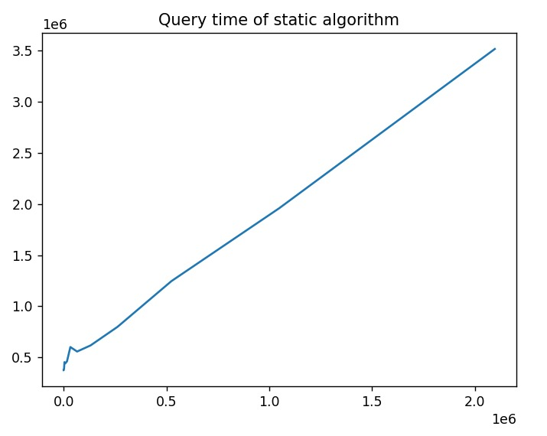
Plots
Caption

Slide 39
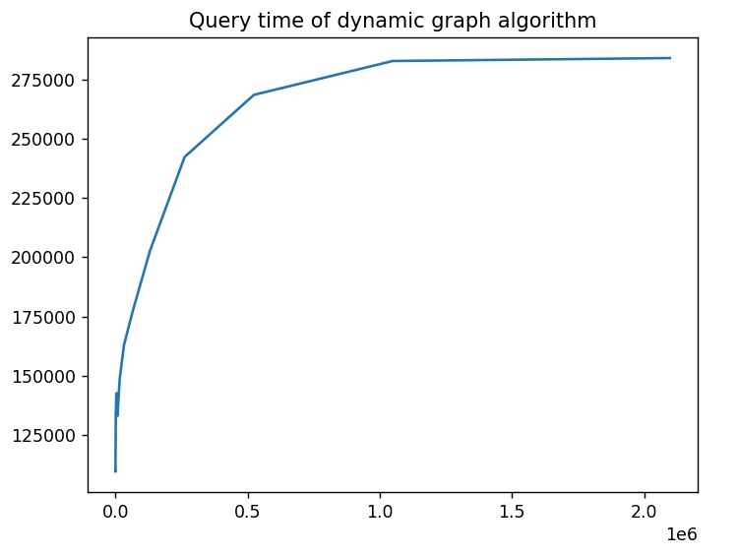
Plots
Caption

Slide 40
THANK YOU

